Slide 1
This is a hidden slide
Dear honorable teacher please follow the instructions that has given in the slide notes (under the every slide). It would be helpful to take a successful class. Thanks a lot. I wish you good luck.

Slide 2
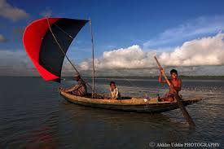
Welcome

Slide 3





Identity
SK. Md. Harunar Rashid – SAT
Sonatola Model High School
Sonatola, Bogra.
01714622498.
Class : Six
English For Today
Lesson : 9
Notes:
Teacher can hide this slide.

Slide 4
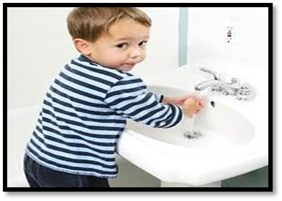
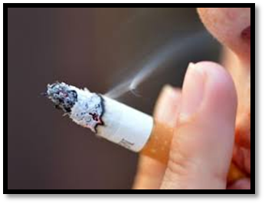
Look at the picture and think
what should/shouldn’t we do?
We should wash our hands before eat.
We shouldn’t practice smoking.
Notes:
Teacher will show the slide for eliciting the lesson declaration.

Slide 5
Lesson Declaration
Today we `ll discuss about
What should we do?
( Lesson – 32 )

Slide 6
Lesson outcomes
By the end of this lesson students will be able to -
read and understand texts through silent reading.
infer meaning from context
Listen for information.
Write answers to questions.

Slide 7
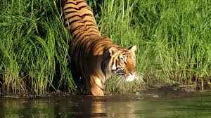
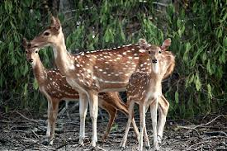
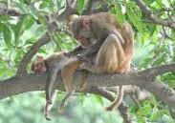
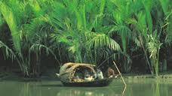
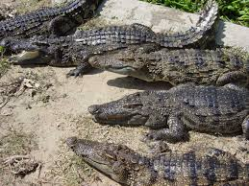
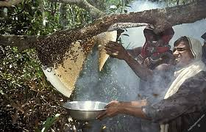
Look at the pictures and guess -
Where we can see these pictures?
At Sunderbans, in Khulna.
Notes:
After showing the pictures teachers can discuss about the Sunderbans.

Slide 8
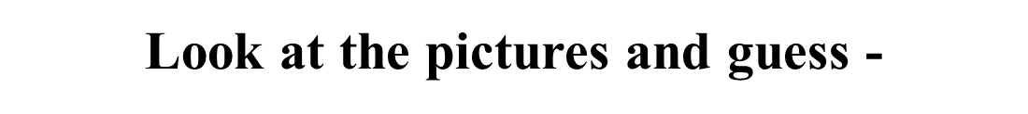
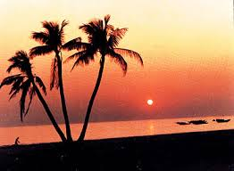
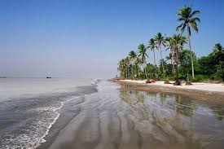
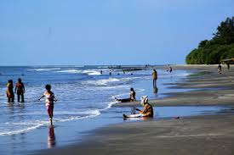
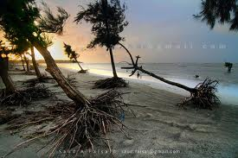
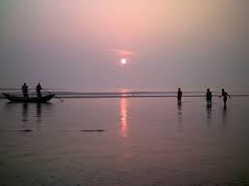
At Kuakata, in Patuakhali.
Where we can see these pictures?
Notes:
After showing the pictures teachers can discuss about the Kuakata.

Slide 9
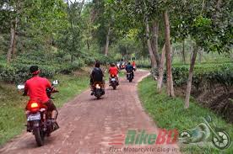
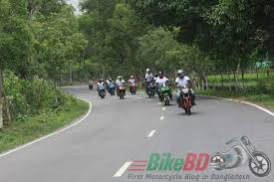
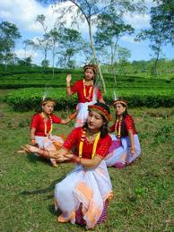
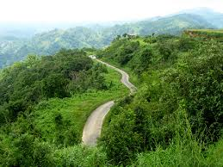
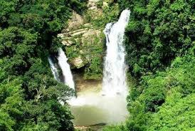
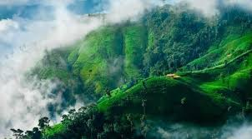
Where we can see these pictures?
At Chimbuk Mountains, in Bandarban.
Notes:
After showing the pictures teachers can discuss about the Chimbuk Mountains.

Slide 10
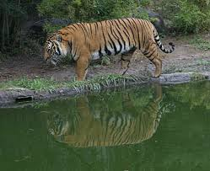
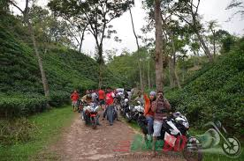
Work in pair
Go to the text and read the section ‘A’ .
Now look at the above pictures and speak about where the friends wanted to go to. Why did they want to go to these places ?
Notes:
Students will read the text then they will write about Sundarbons, Kuakata and Chimbuk Mountains.

Slide 11

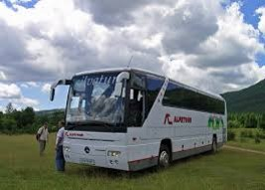
Trip
Key word
We are going for three days trip to Mymensingh.
Meaning
(Click here)
Journey / expedition
Notes:
First, the word can be shown. The SS can be asked to pronounce the word. If it is needed teacher can help. Then the picture can be shown and asked to guess the meaning. For feedback click on meaning button.

Slide 12
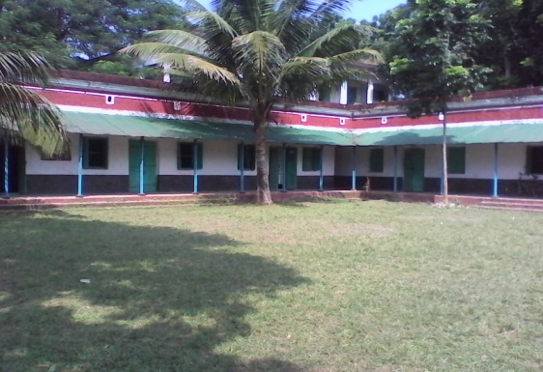
Vacation
Key word
We have a week’s vacation next month.
Meaning
(Click here)
Break, leave, rest.
Notes:
First, the word can be shown. The SS can be asked to pronounce the word. If it is needed teacher can help. Then the picture can be shown and asked to guess the meaning. For feedback click on meaning button.

Slide 13
Fantastic
Key word
The sceneries of Kuakata are fantastic.
Meaning
(Click here)
Marvelous / romantic.
Notes:
First, the word can be shown. The SS can be asked to pronounce the word. If it is needed teacher can help. Then the picture can be shown and asked to guess the meaning. For feedback click on meaning button.

Slide 14
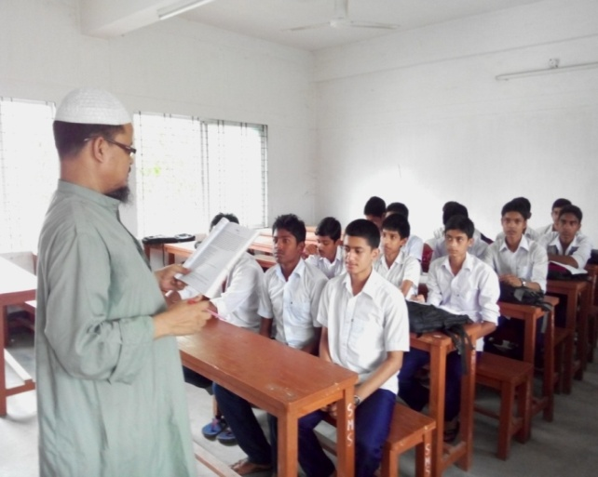
Listen to me and fill in the gaps
Sujan
Bahar, Azim, Josheph and -------- are class-mates. They are planning a -------- . Bahar wanted to go to ------------- . Azim wanted to go to ------------ mountains in Bandarbon. But Sujan wanted to go to Sundarbans, where we can see some ---------- animals.
vacation
Kuakata
Chimbuk
wild
Notes:
Students can write the answer on black or white board.

Slide 15
Pair Works
Watch the video clip and write a short note on it.
Click here
Notes:
Students will write about Sundarbons.

Slide 16
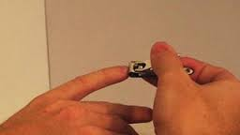
Go to the text and notice the use of should and shouldn’t.
Should is used for : Suggestion, obligation, duty, advice, emphasis, polite request.
Example :
We should cut our nails regularly.
Notes:
At first teacher may discuss about grammar focus then will give the task. For slide no. 15, 16 and 17.

Slide 17
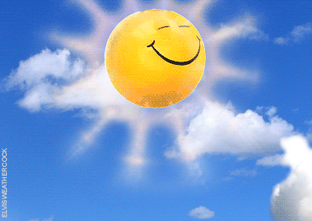
Use of shouldn’t
Shouldn’t also used for : Suggestion, advice, but negative sense.
Example :
We shouldn’t play in the sun.
Notes:
At first teacher may discuss about grammar focus then will give the task. For slide no. 15, 16 and 17.

Slide 18
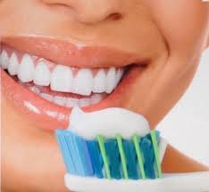
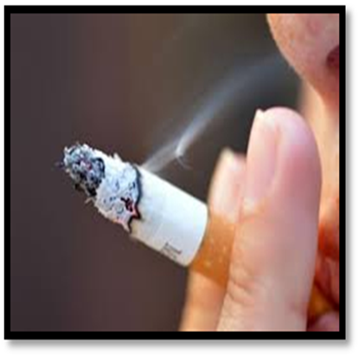
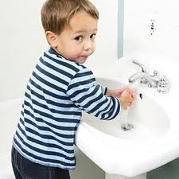
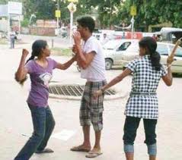
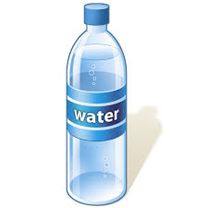
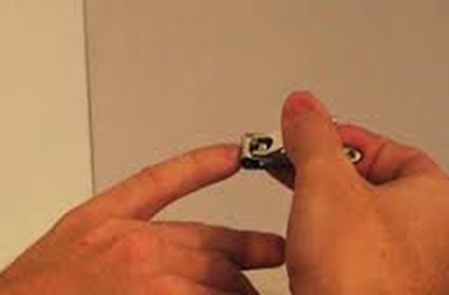
Individual Works
Make sentences using should/shouldn’t : Structure: Sub + should/shouldn’t + main verb + others.
Notes:
At first teacher may discuss about grammar focus then will give the task.

Slide 19
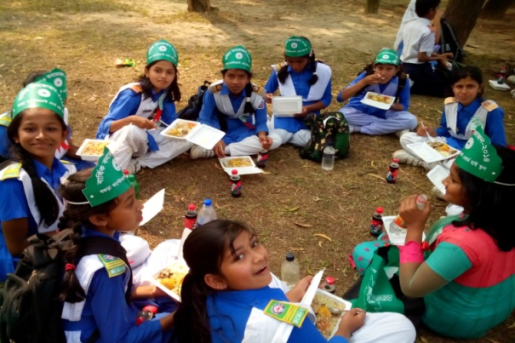
Home work
Write a short description about the picnic, where did you go in this year.
Notes:
Teacher can give short description about the home task.

Slide 20
Acknowledgement
We would like to express our cordial gratitude to the Ministry of Education, Directorate of Secondary & Higher Education, NCTB, a2i
and
the panel of honorable editors ( Md. Jahangir Hasan, Associate Professor (English) TTC, Rangpur, Ranjit Poddar, Associate Professor (English) TTC, Dhaka, and Urmila Ahmed, Associate Professor (English) TTC, Dhaka, to enrich the contents.

Slide 21
THE END

